Slide 1
ENGLISH DEPARTMENT Miss Carol Eckhardt I.-
5th Grades
April 28th, 2020
Let love be the motto of your life M.P.v.M

Slide 2
If in this PPT you have any question or suggestion please send me an email to: miss.eckhardt@hotmail.com You can check vocabulary in this online dictionary: https://dictionary.cambridge.org/dictionary/english-spanish/table

Slide 3
Identify specific information by reading a short text about annie’s family, then complete the activities according to it. Be perseverant.
Capacity: | Skills: | Contents: | Value: | Attitude:
Logical Reasoning | Identify | Unit 1 “My World” (Starter Unit) | Faith | Perseverant

Slide 4
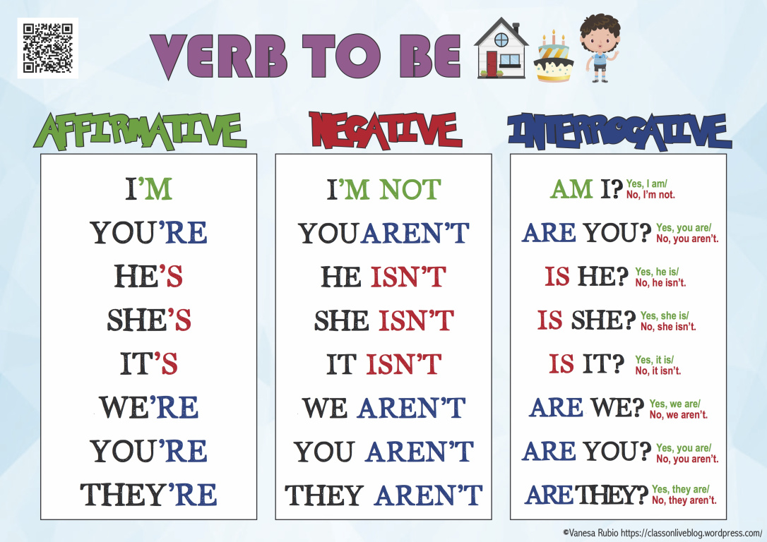
Present simple: Verb to be

Slide 5
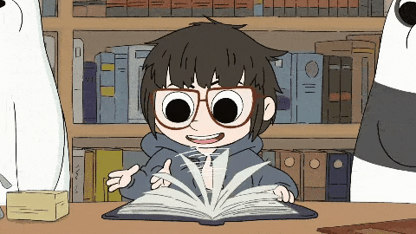
MY FAMILY
Hello! My name is Anne but everyone calls me any, that is my surname. ME AND MY FAMILY ARE FROM UNITED KINGDOM. I AM SEVEN YEARS OLD and i am into k- pop music. I HAVE GOT ONE BROTHER AND ONE SISTER. THEY ARE OLDER. HE IS EIGHT AND SHE IS TEN and both like playing chess and they are really good. MY MUM IS A DOCTOR, she Works hard everyday, specially now that we are facing this global pandemic. MY DAD IS NOT A DOCTOR, HE IS A TEACHER. He teaches languages, french and spanish. Now he is on his armchair reading a magazine. WE ARE VERY HAPPY BECAUSE IT IS SATURDAY AND WE ARE all together.

Slide 6
True or false: Read and circle true or false
He is seven years old. true false
His sister is six years old. true false
His dad is a teacher. true false
They are sad today. true false

Slide 7
Choose the answer: Read the sentence. Circle the correct answer.
I ……………… 12 years old. Am not/is not/are
My brother ……………… at university. is not/ is/ are
He ………………good at chess. IS/ s’ not/ note
……………… THEY in the school? Are/ is/ am
I ……………… INTO ROCK MUSIC. AM/ AM NOT/IS NOT
They ……………… TIRED Arent/ aren’t/ ares

Slide 8
Make it right!: find the mistake, underline it and write it correctly.
We not tired. ……are….. WE ARE NOT TIRED
I from turkey. …………… …………………………………
They is at the park. …………… …………………………………
ARE SHE YOUNG ? …………… …………………………………
Im very tall. …………… …………………………………
My dad are an engineer. …………… …………………………………
He’s n’t angry. …………… …………………………………

Slide 9
Pictionary!: write the new vocabulary for you, translate it and draw. There is an example below.
FAMILY | FAMILIA

Slide 10
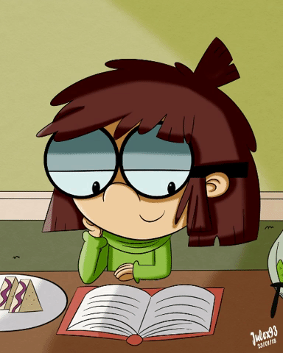
THANK YOU FOR YOUR HARD WORK. MISS YOU !

