Slide 1
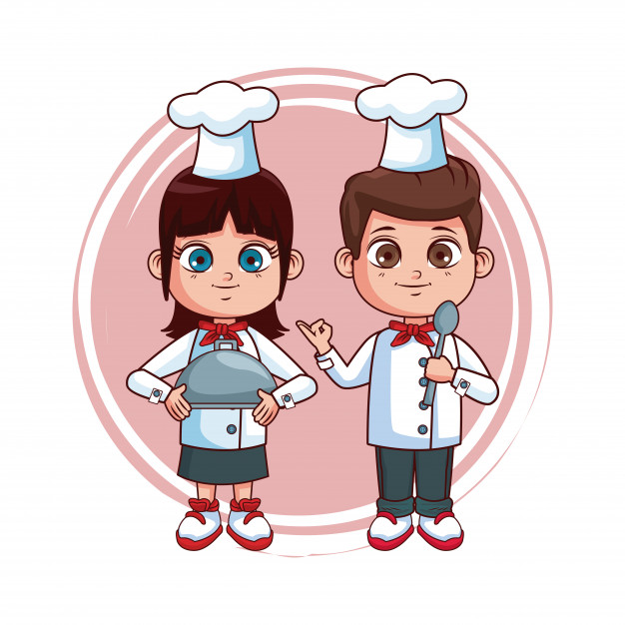





ENGLISH DEPARTMENT Miss Carol Eckhardt I.-
6th Grades
April 28th, 2020
Let love be the motto of your life M.P.v.M

Slide 2
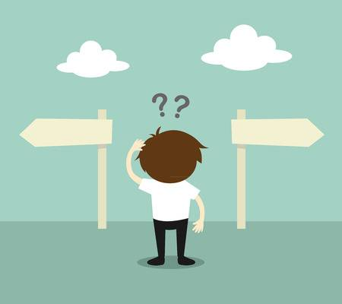

If in this PPT you have any question or suggestion please send me an email to: miss.eckhardt@hotmail.com This time check vocabulary in this online dictionary: https://dictionary.cambridge.org/dictionary/english-spanish/table

Slide 3
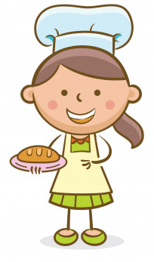
THIS WEEK WE ARE GOING TO LEARN VOCABULARY RELATED TO HEALTHY LIFE
Capacity: | Skills: | Contents: | Value: | Attitude:
Logical Reasoning | Identify | Unit 1 “Food and Health” | Faith | committed

Slide 4
1. Objective: Identify vocabulary related to cooking and healthy life by reading a short recipe. Then complete the exercises. Be committed.

Slide 5
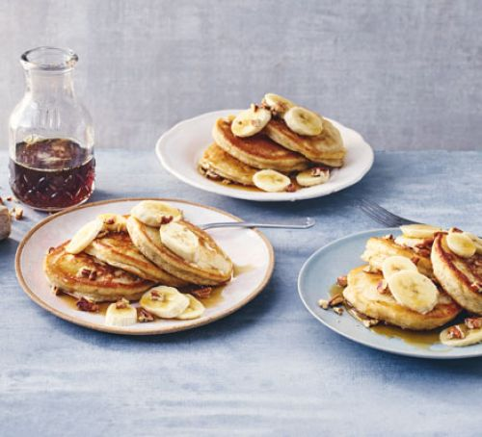
Easy banana pancakes

Slide 6
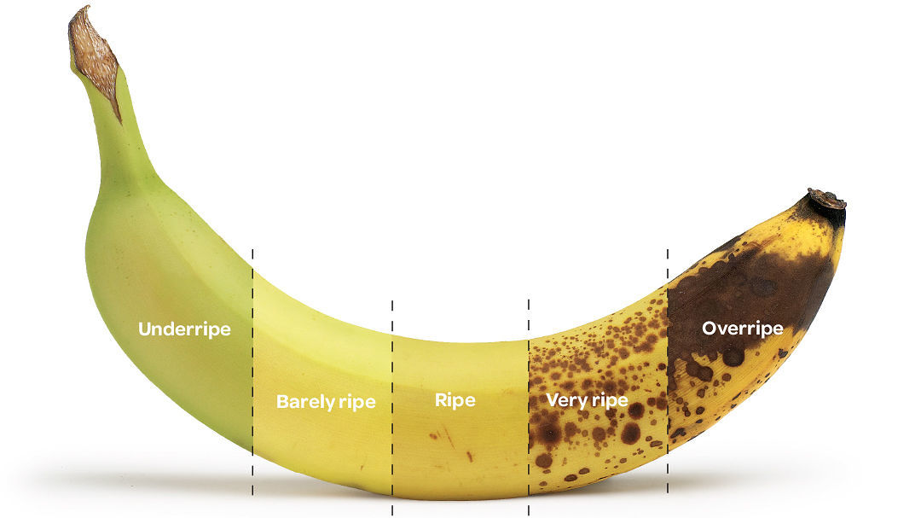
Ingredients
350g self-raising flour
1 tsp baking powder
2 very ripe bananas
2 medium eggs
1 tsp vanilla extract
250ml whole milk
Butter, for frying

Slide 7
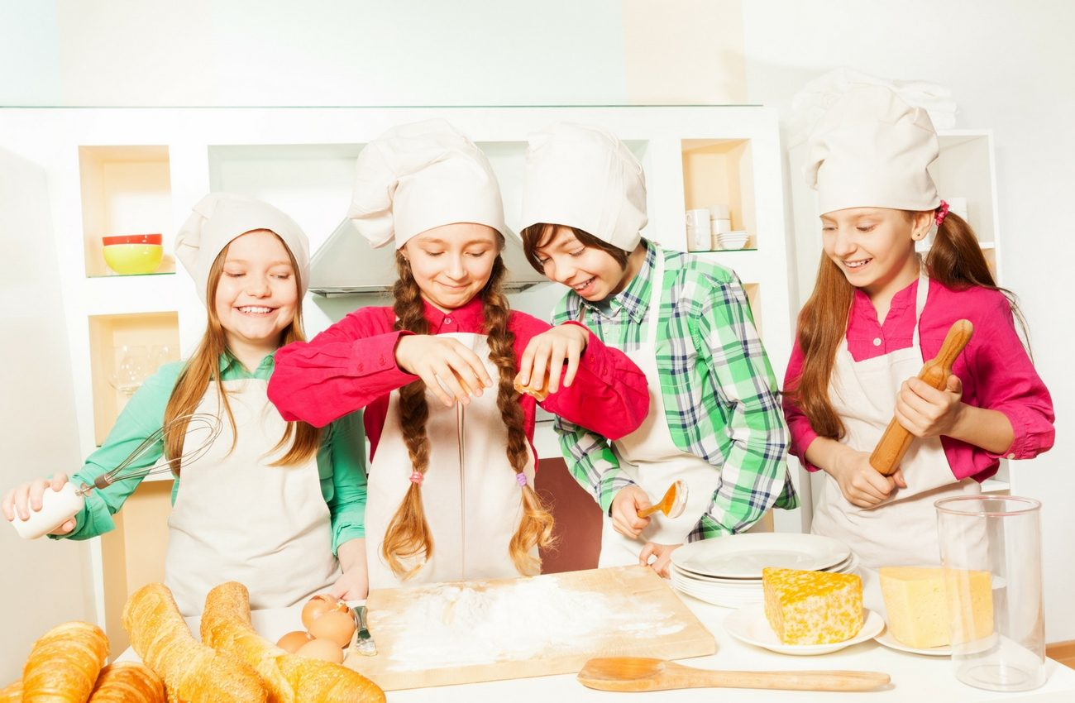
Method
Sieve the flour, baking powder and a generous pinch of salt into a large bowl. In a separate mixing bowl, mash the very ripe bananas with a fork until smooth, then whisk in the eggs, vanilla extract and milk. Make a well in the centre of the dry ingredients, tip in the wet ingredients and swiftly whisk together to create a smooth, silky batter.

Slide 8
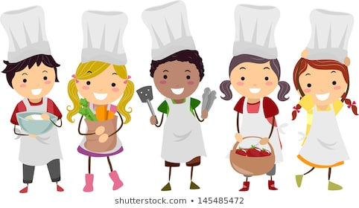
Heat a little knob of butter in a large non-stick pan over a medium heat. Add 2-3 tbsp of the batter to the pan and cook for several minutes, or until small bubbles start appearing on the surface. Flip the pancake over and cook for 1-2 mins on the other side. Repeat with the remaining batter, keeping the pancakes warm in a low oven.

Slide 9
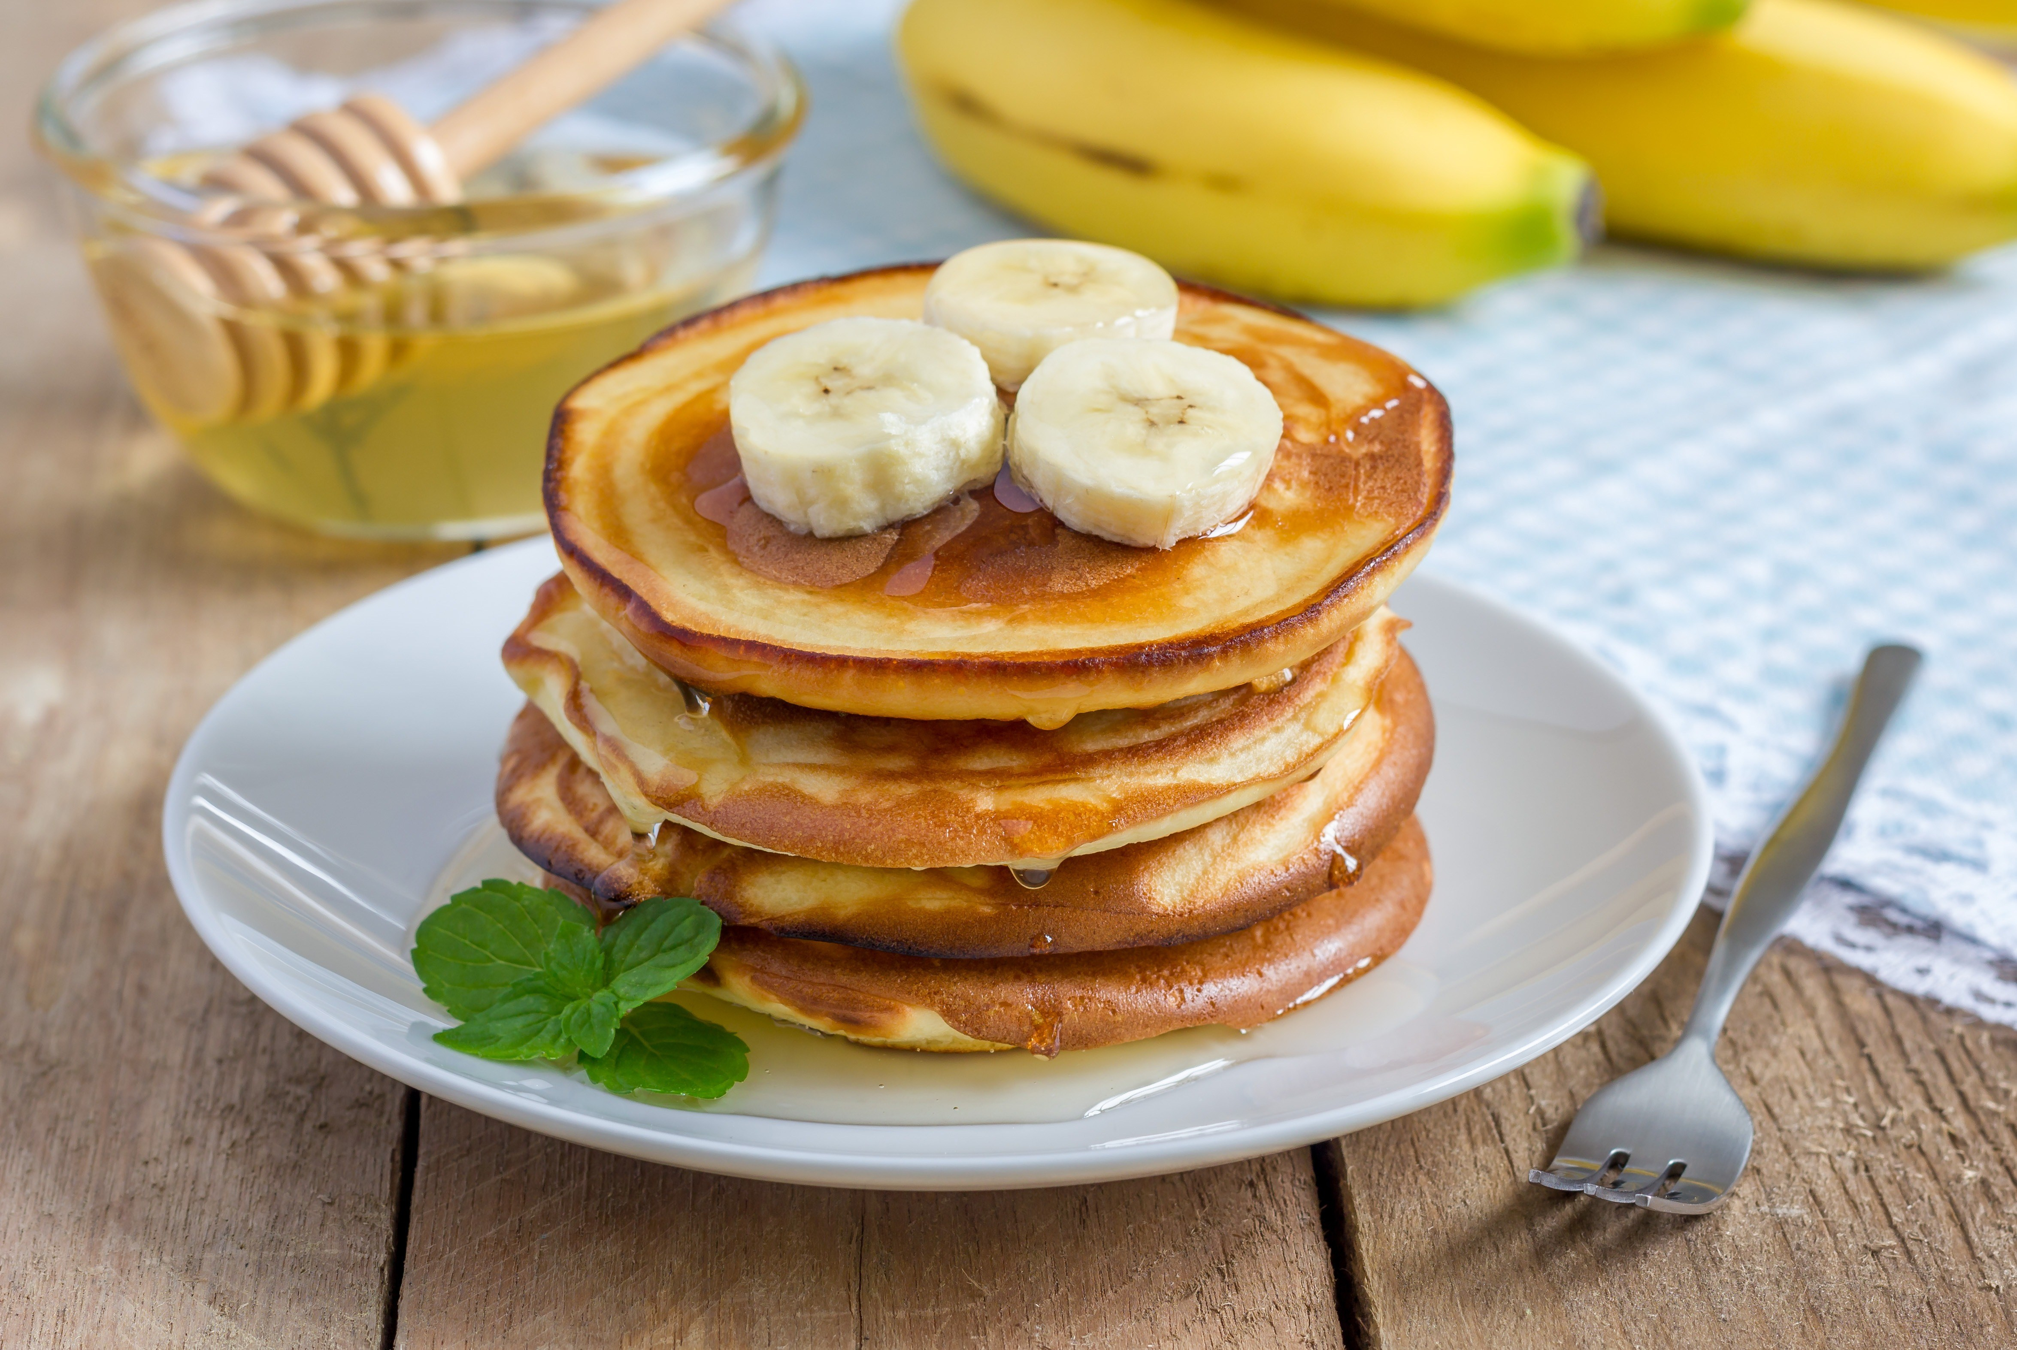
Stack the pancakes on plates and top with the banana slices, a glug of sticky maple syrup and a handful of pecan nuts, if you like.

Slide 10
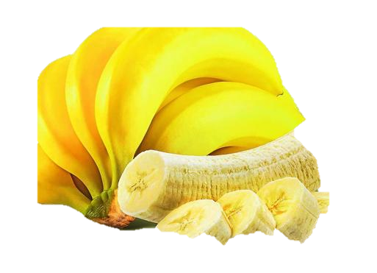
CHECK YOUR NEW VOCABULARY!
INGREDIENTS
EXAMPLE:
BANANA: Plátano

Slide 11
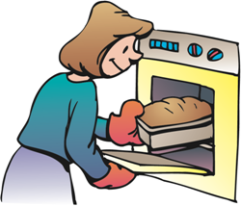
COOKING VERBS
Example:
Bake: Hornear

Slide 12
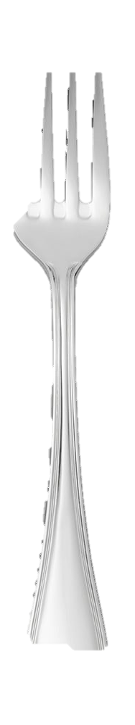
Utensils
Example:
Fork: Tenedor

Slide 13
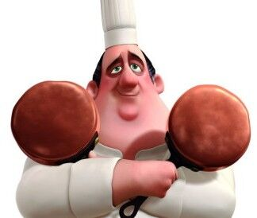
If you have time and if you want, do this recipe and send me a picture! You can spend a good time cooking with your family! And as Gusteau says “Anyone can cook” Good luck! (Do this with the permission and supervision of your parents)

