Slide 1
ENGLISH DEPARTMENT Miss Carol Eckhardt I.- Miss Ximena Vera.-
7th Grades
April 28th, 2020
Let love be the motto of your life M.P.v.M

Slide 2
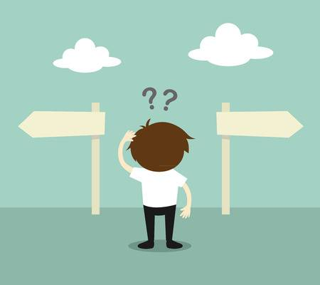
If in this PPT you have any question or suggestion please feel free to ask questions at: miss.eckhardt@hotmail.com or ximealevera@gmail.com We will answer your questions from Monday to Friday (08:00 – 16:00 hrs). This time check your new vocabulary in this online dictionary: https://dictionary.cambridge.org/dictionary/english-spanish/table Read the visual explanation and examples carefully.

Slide 3
1. Objective: Infer information related to the conversation “Shopping” and complete the exercises given below. Work being committed.
Capacity: | Skills: | Contents: | Value: | Attitude:
Logical Reasoning | Infer | Unit 1 “Feelings and opinions” | Faith | Committed

Slide 4
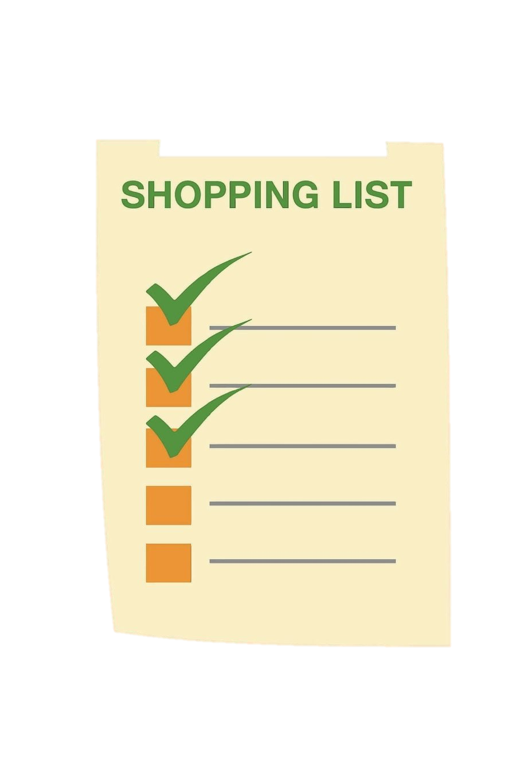
Shopping
George: I’m going out. Do you want anything?
Sally: Could you buy some stuff from the shop?
George: All right. What do you want?
Sally: Well, we haven’t got much milk.
George: How much milk do you want?
Sally: We need two bottles of milk.
George: How about strawberry jam? Have we got any jam?
Sally: Oh yes, there isn’t any jam left. We need a jar of strawberry jam. And also we’ve finished the butter. We need some butter.

Slide 5
George: OK. I think I‘ve finished the last beer. I’ll buy 5 or 6 bottles of beer.
Sally: OK. There is a little oil left. Please, buy a bottle of oil.
George: No problem. Do you want to eat fish at dinner?
Sally: Ah, yes. I want you to buy four tins of fish, and also some bread. There isn’t much bread left.
George: How many loaves of bread do you want?
Sally: A loaf of brown bread is enough. Would you like some coffee after dinner?
George: Of course.

Slide 6
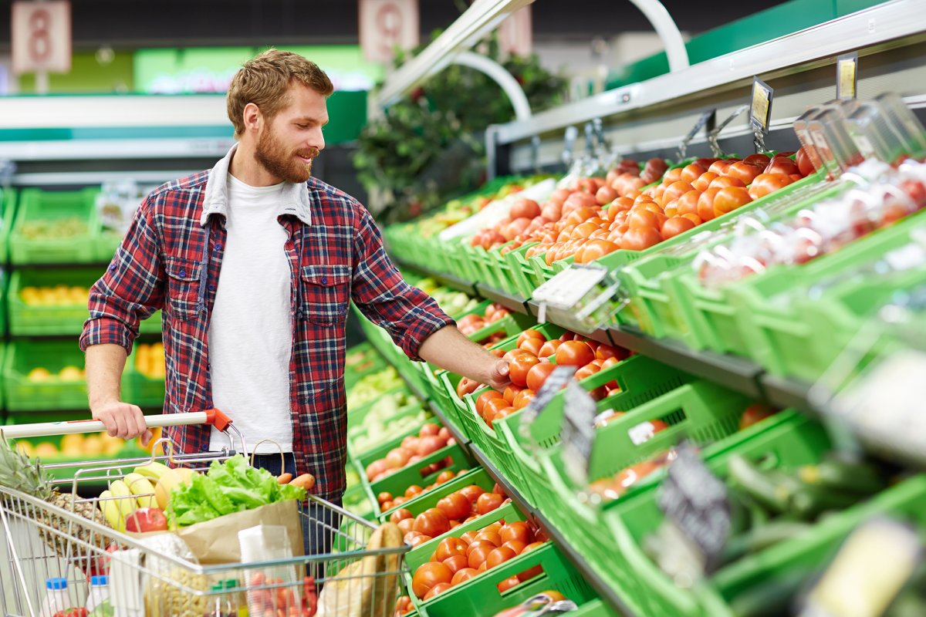
Sally: Then, buy us a bag of coffee. At last, we only have few packets of pasta. Could you buy some more pasta? You know we eat pasta almost every day.
George: Ok, no problem.
Sally: One more thing. Don’t buy any almonds. We have got a lot of almonds.
George: All right!

Slide 7
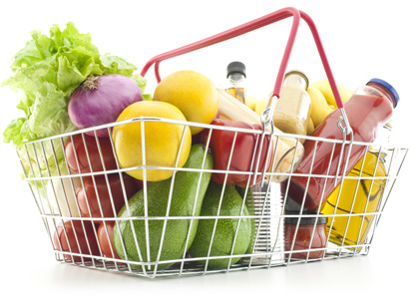
According to the conversation: Are they true or false?
1. There isn’t any butter. ______
2. Sally and George have got a little beer. ______
3. George is going to buy a lot of fish._____
4. There is some bread. ______
5. They don’t need any coffee. ______
6. There is little pasta for them. ______

Slide 8
Read the dialogue again and draw some examples
Some
Much
Many
Few

Slide 9
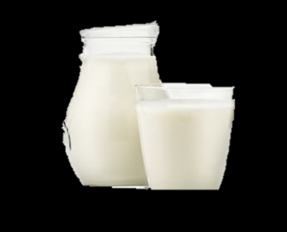
CHECK YOUR NEW VOCABULARY!
FOOD
EXAMPLE:
Milk: Leche

Slide 10
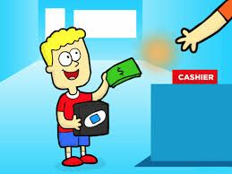
VERBS
Example:
Buy: Comprar

Slide 11
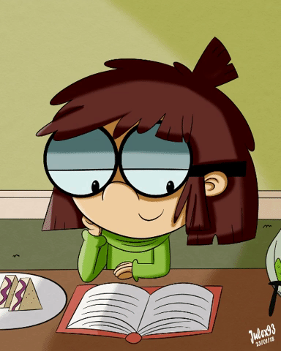
Thank you for your time and hard work!

